Slide 1

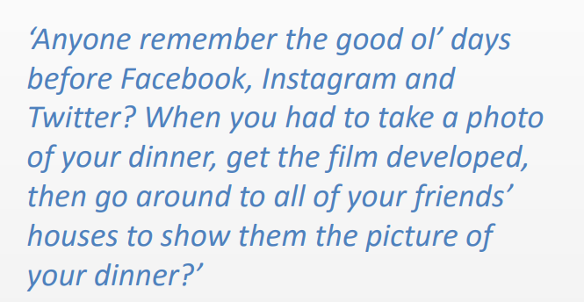
Igniting young minds today, for a brighter tomorrow
Ready . Respect . Safe
Internet Safety Talk

Slide 2
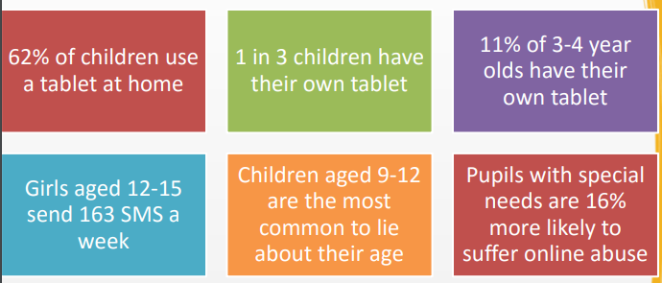
Statistics

Slide 3

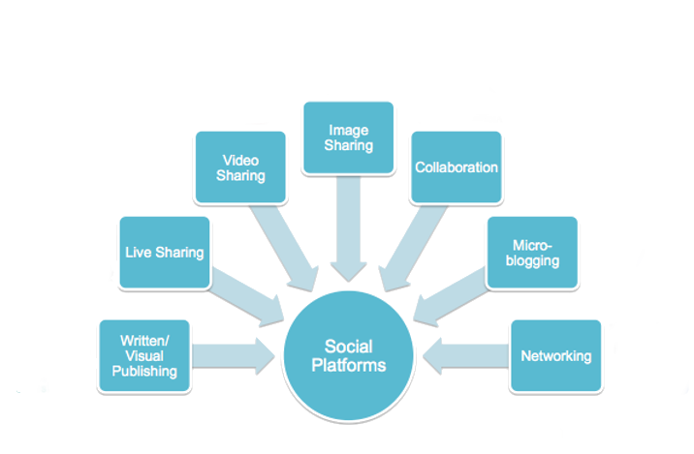














Social Media Platforms

Slide 4
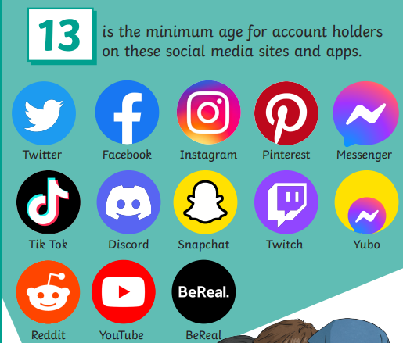
Legal age to using Social media platforms

Slide 5
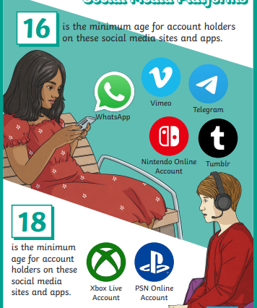
Legal age to using Social media platforms

Slide 6
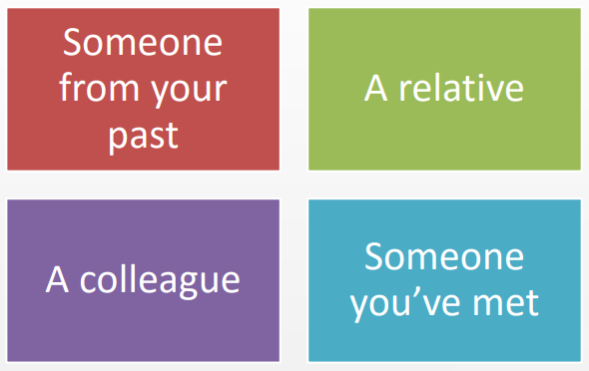
Adults definition of a friend:

Slide 7
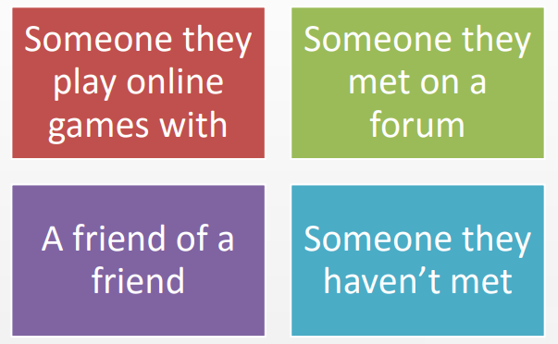
Children’s definition of a friend:

Slide 8
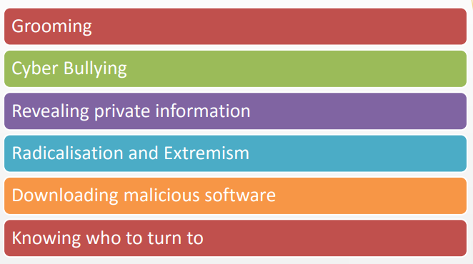
What issues do children face online?

Slide 9
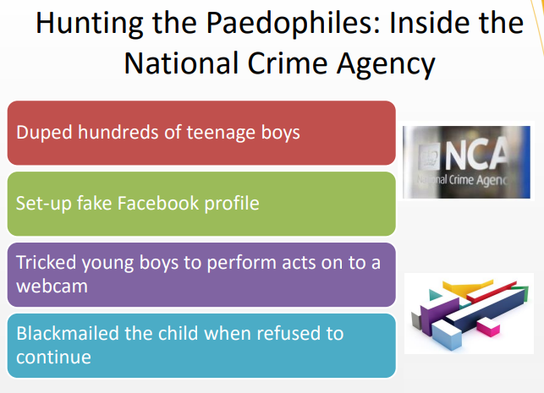
Grooming

Slide 10
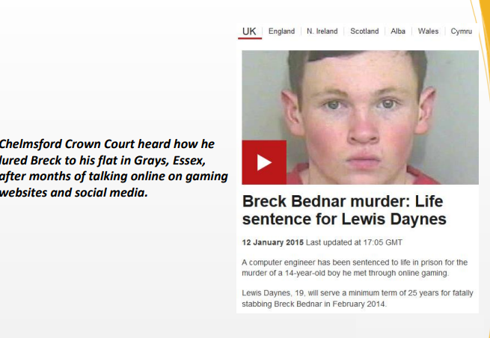
Grooming

Slide 11
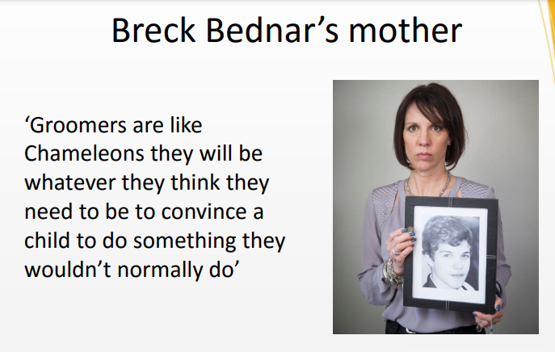
Grooming

Slide 12

Grooming

Slide 13
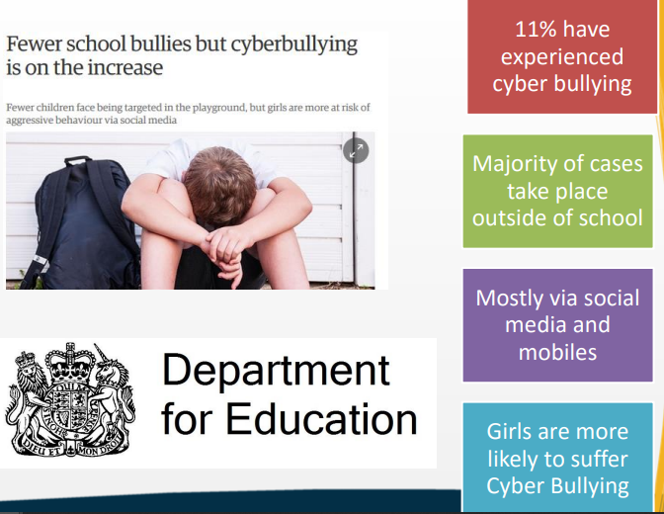
Cyber Bullying

Slide 14

Cyber Bullying

Slide 15
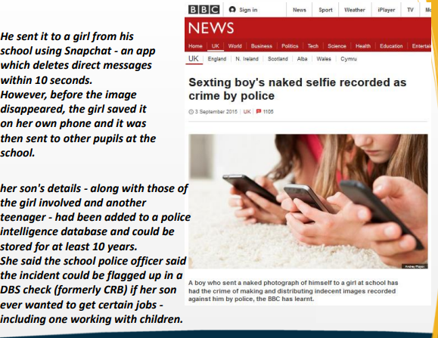
Sexting

Slide 16
Sexting

Slide 17

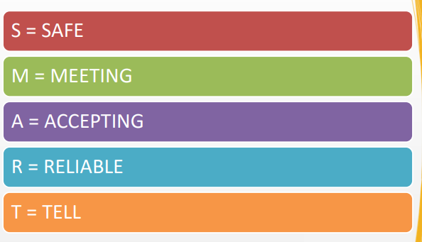

Slide 18
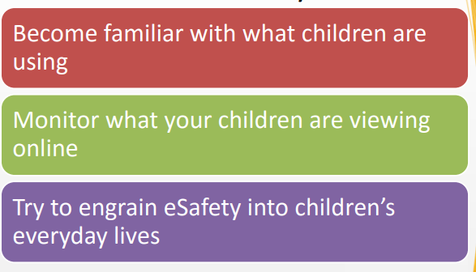
Tips for parents

Slide 19
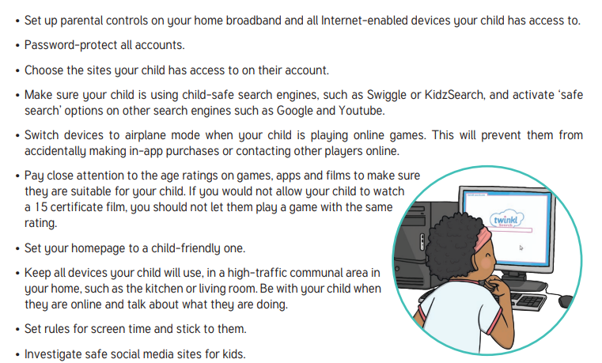
Tips for parents

Slide 20
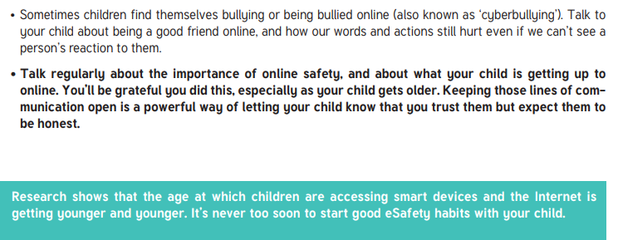
Tips for parents

Slide 21
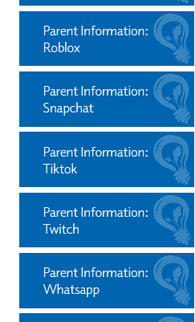
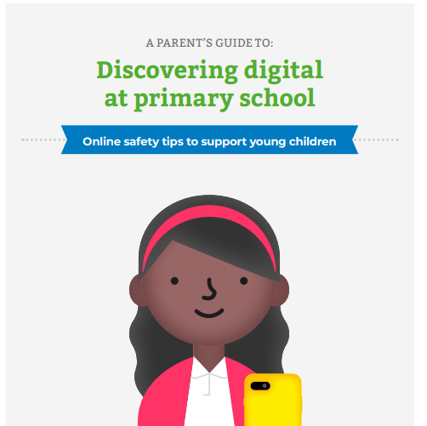
Tips for parents
https://www.edisonprimary.org/curriculum/computing/

